Slide 2
How to Build ASP.NET Web Applications Using Async
DEV-B337
Rowan Miller

Slide 3
Agenda
A brief history of async in .NET
Async scenarios with demos
Tips, tricks & no-nos

Slide 4
A brief history of async in .NET

Slide 5
A brief history of async in .NET .NET Framework 1.0
No asynchronous programming model

Slide 6
A brief history of async in .NET .NET Framework 1.1
Asynchronous programing model (APM)
Call BeginXyz which returns IAsyncResult
Watch IAsyncResult until completed
Call EndXyz to get the actual result
IAsyncResult ar = BeginSomething(…);
// Do other work, checking ar.IsCompleted
int result = EndSomething(ar);

Slide 7
A brief history of async in .NET .NET Framework 2.0
Event-based asynchronous pattern (EAP)
Subscribe to XyzCompleted
Call XyzAsync to start work
SomethingCompleted += (sender, e) =>
{
// Do something with result
};
SomethingAsync(…);

Slide 8
A brief history of async in .NET .NET Framework 4.0
Task Paralell Library (TPL)
Call XyzAsync which return Task<TResult>
Watch Task until completed
Get result directly from Task
Task<int> task = SomethingAsync(…);
// Do other work, checking task.Status
int result = task.Result;

Slide 9
A brief history of async in .NET .NET Framework 4.5
async/await keywords
Your code structured the same as synchronous code
Compiler creates async code using TPL
int result = await SomethingAsync(…);

Slide 10
Async scenarios

Slide 11
Asynchronous != parallel
Parallel
Multiple operations executing at once
Operations start/complete at different times
Sequential
Ordered set of steps
Code executes when previous operation is done
Asynchronous
Thread only blocked when there is work to do
Synchronous
Thread is blocked until execution completes

Slide 12
Async scenarios
I/O operations (database, file, network, etc.)
Parallelism
Long-running event-driven (streaming, long polling, etc.)

Slide 13
I/O operations

Slide 14




Traditional web request handling
Request Queue
Busy
Busy
Busy
Busy
Thread Pool

Slide 15
Synchronous Code
public int SumPageSizes(IList<Uri> uris) { int total = 0; foreach (var uri in uris) { var data = new WebClient().DownloadData(uri); total += data.Length; } return total; }

Slide 16


Asynchronous web request handling
Request Queue
Thread Pool

Slide 17
Synchronous Code
public int SumPageSizes(IList<Uri> uris) { int total = 0; foreach (var uri in uris) { var data = new WebClient().DownloadData(uri); total += data.Length; } return total; }

Slide 18
Asynchronous code without async/await
public void SumPageSizesAsync(IList<Uri> uris, Action<int, Exception> callback)
{ SumPageSizesAsyncHelper(uris.GetEnumerator(), 0, callback); } private void SumPageSizesAsyncHelper(IEnumerator<Uri> enumerator, int total, Action<int, Exception> callback)
{ try
{ if (enumerator.MoveNext())
{ var client = new WebClient(); client.DownloadDataCompleted += (sender, e) =>
{ if (e.Error != null)
{
enumerator.Dispose();
callback(0, e.Error);
} else SumPageSizesAsyncHelper(enumerator, total + e.Result.Length, callback); }; client.DownloadDataAsync(enumerator.Current); } else
{ enumerator.Dispose(); callback(total, null); } } catch (Exception ex)
{
enumerator.Dispose(); callback(0, ex); } }

Slide 19
Synchronous Code
public int SumPageSizes(IList<Uri> uris) { int total = 0; foreach (var uri in uris) { var data = new WebClient().DownloadData(uri); total += data.Length; } return total; }

Slide 20
Asynchronous code using async/await
public async Task<int> SumPageSizesAsync(IList<Uri> uris) { int total = 0; foreach (var uri in uris) { var data = await new WebClient().DownloadDataTasksync(uri); total += data.Length; } return total; }

Slide 21
Demo
Async in ASP.Net WebForms

Slide 22
WebForms takeaways
Await frees up thread until operation is finished
Using async does not affect client
Set Async page attribute to use new async pipeline
Always use RegisterAsyncTask to call async code
ASP.NET takes care of thread affinity

Slide 23
Demo
Async in ASP.NET WebAPI/MVC

Slide 24
MVC/WebAPI takeaways
Async is simple - just mark the action as async
Async is transparent to callers of WebAPI
Entity Framework 6 enables async database calls

Slide 25
I/O operations Error conditions

Slide 26
Cancellation tokens
Allow caller to terminate an in-flight async task
ASP.NET has three built-in tokens
RequestTimeout, ClientDisconnected, & AsyncTimeout

Slide 27
Demo
Cancellation tokens

Slide 28
Cancellation tokens takeaways
Cancellation tokens further reduce thread usage
ASP.NET has built in cancellation tokens
Use CancellationTokenSource to combine tokens

Slide 29
Parallelism

Slide 30
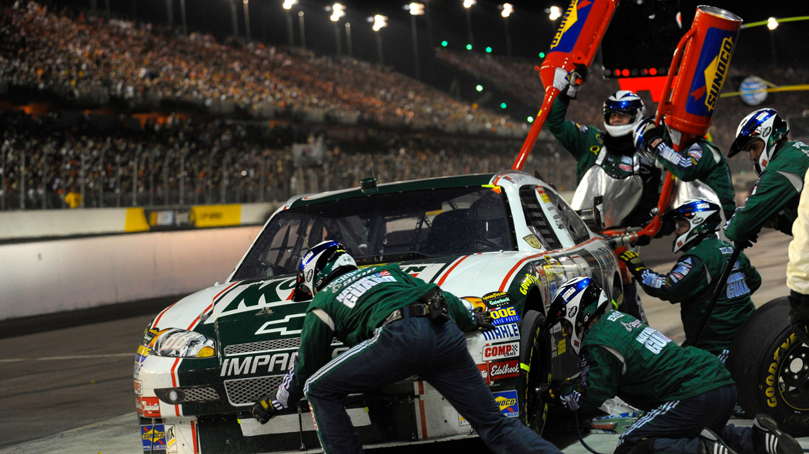

Slide 31
Two types of parallelism
Multiple asynchronous operations
Two or more awaitable operations
No additional threads used
Multiple synchronous operations
Task.Run, ThreadPool.QueueUserWorkItem, etc.
Each operation uses a thread
Same thread pool as ASP.NET

Slide 32
Demo
Parallelism

Slide 33
Parallelism takeaways
Parallelism can reduce request time
Be careful with synchronous parallelism
Threads come from same pool used to serve requests

Slide 34
Demo
Async in an HttpHandler

Slide 35
Tips, tricks & no-nos

Slide 36
Avoid work on “background threads”
There are no background threads on servers
All threads come form the same pool used to serve requests
Moving to another thread just adds cost
Use Task.FromResult if result needs to look async
TaskCompletionSource<T> if you need to return non-result (faulted, cancelled, etc.)

Slide 37
Using ASP.NET intrinsics on worker threads
HttpContext.Current, Request, Response, etc.
Not setup to use on worker threads you start
Async/await will take care of this for you
Provided you start using them on the request thread
Alternative is to use SynchronizationContext.Post

Slide 38
Avoid using Task.Wait
Calling Wait blocks the current thread
Task.Result on an uncompleted task also blocks
Can easily cause deadlocks in ASP.NET
Use await or Task.WhenAll instead

Slide 39
Demo
Deadlocks from using Task.Wait

Slide 40
Avoid Task.ContinueWith
ContinueWith is not aware of SynchronizationContext
Always puts you on a new thread
Use async/await instead

Slide 41
Be careful with parallelism
Multiple requests * multiple threads = a lot of threads
All threads come form the same pool used to serve requests
Threads consume min ¼Mb memory each
Kicking off multiple awaitable async tasks is fine

Slide 42
Don’t use thread local storage
You may swap physical threads
Don’t use [ThreadStatic]
Use HttpContext.Items
If your using async/await ASP.NET will take care of thread hops
Don’t assume this doesn’t apply to your sync code
Other async components in the pipeline can cause thread hops

Slide 43
Don’t call fire & forget methods
Your code could be terminated at any time
Use WebBackgrounder
http://nuget.org/packages/WebBackgrounder/
Write a worker process for more complex tasks

Slide 44
Use HttpTaskAsyncHandler
IHttpAsyncHandler is a complicated interface
HttpTaskAsyncHandler takes care of a lot for you

Slide 45

Resources
Parallel Programming with .NET Blog http://blogs.msdn.com/pfxteam/
Asynchrony in .NET Whitepaper http://msdn.com/library/vstudio/hh191443.aspx
ASP.NET Async Tutorial http://www.asp.net/web-forms/tutorials/aspnet-45/using-asynchronous-methods-in-aspnet-45

Slide 46



Plan details and subscriber benefits
Free Plan for up to 5 users
Included for certain paid MSDN subscribers:
Version control (TFVC or Git)
Comment on changesets & commits
Work item tracking and tagging
Team rooms
Agile planning tools
Feedback Management
Agile Portfolio Management*
Build*
Web-based test case management*
Load testing*
New!
New!
New!
New!
Additional information at http://tfs.visualstudio.com
* Capability in preview – limits may apply. Authoring load tests requires Visual Studio Ultimate 2013 Preview.

Slide 47

MSDN Subscribers – Accelerate Your Development & Test using Cloud VMs We’ve enhanced the Windows Azure MSDN benefit and added cloud use rights for select MSDN software. You’ve already got it, now use it!
Activate and try out your Windows Azure MSDN benefit today & you could win an Aston Martin V8 Vantage!
Learn more and activate today at http://aka.ms/AzureContest

Slide 48
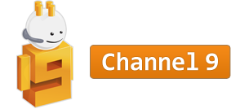
Resources
Learning
Sessions on Demand
Microsoft Certification & Training Resources
http://channel9.msdn.com/Events/TechEd
www.microsoft.com/learning
TechNet
msdn
Resources for IT Professionals
Resources for Developers
http://microsoft.com/technet
http://microsoft.com/msdn

Slide 49







Complete an evaluation on CommNet and enter to win!

Slide 50
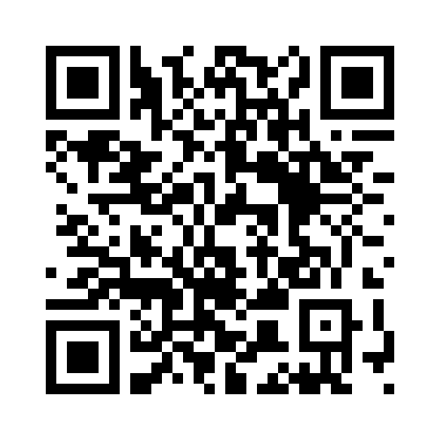

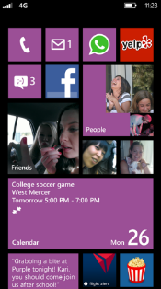
Evaluate this session
Required Slide
*delete this box when your slide is finalized
Your MS Tag will be inserted here during the final scrub.
Scan this QR code to evaluate this session and be automatically entered in a drawing to win a prize

Slide 51

© 2013 Microsoft Corporation. All rights reserved. Microsoft, Windows and other product names are or may be registered trademarks and/or trademarks in the U.S. and/or other countries.
The information herein is for informational purposes only and represents the current view of Microsoft Corporation as of the date of this presentation. Because Microsoft must respond to changing market conditions, it should not be interpreted to be a commitment on the part of Microsoft, and Microsoft cannot guarantee the accuracy of any information provided after the date of this presentation. MICROSOFT MAKES NO WARRANTIES, EXPRESS, IMPLIED OR STATUTORY, AS TO THE INFORMATION IN THIS PRESENTATION.

